Slide 1
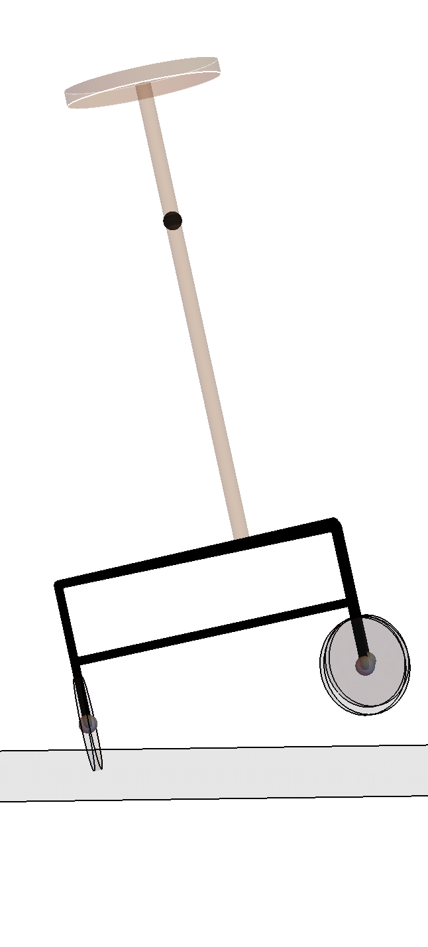
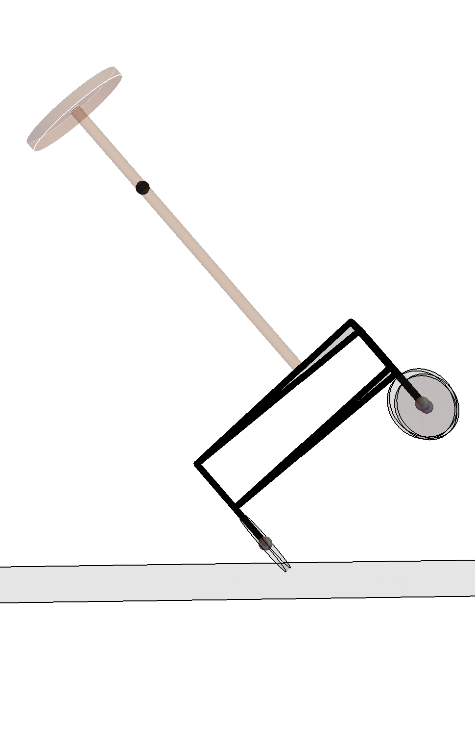

Slide 2
L
R
L
R
L
R
L=R
L>R
L=-R
(a)
(b)
(c)

Slide 3
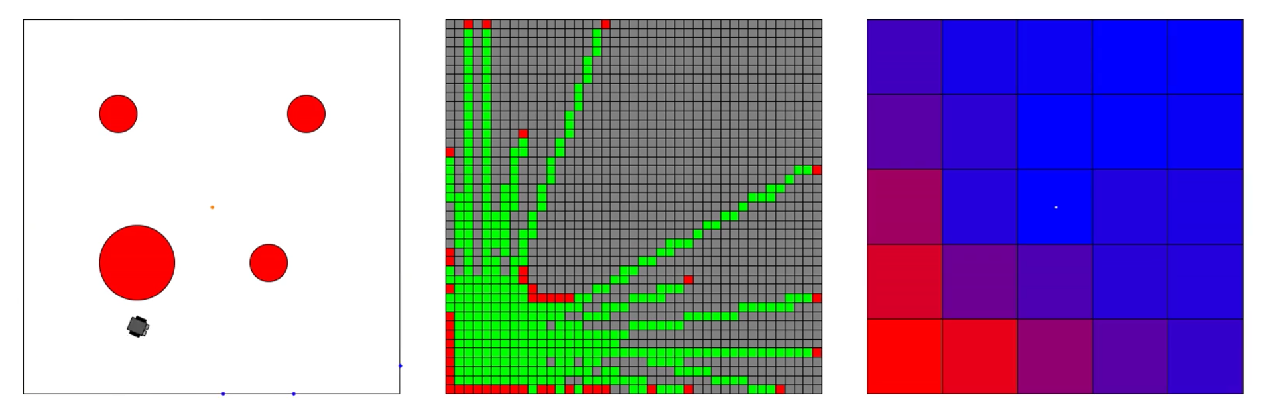
Simulated Environment
Mapped Environment
Level of discovery
Obstacles
Target
Start
Measurement points

Slide 4
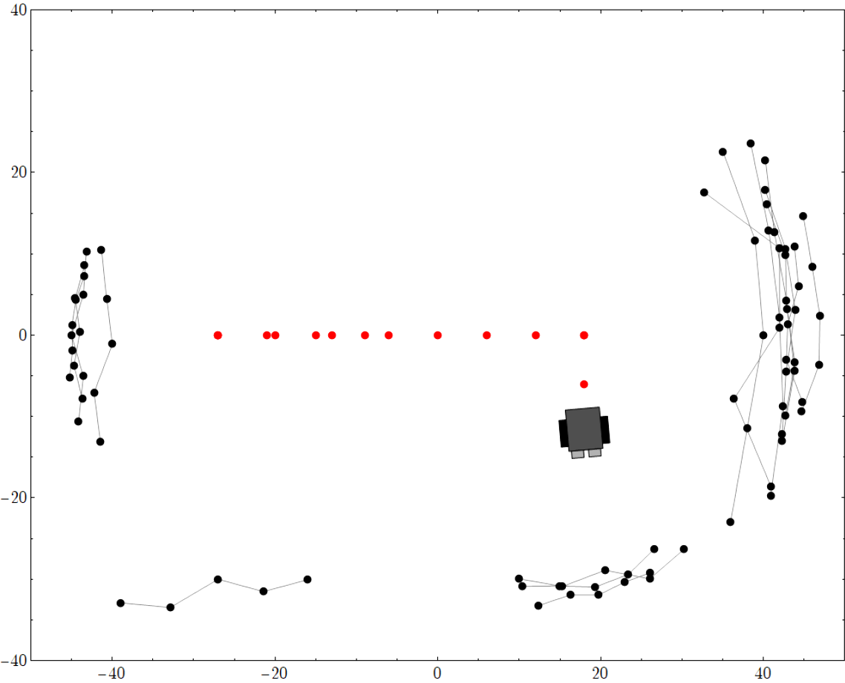
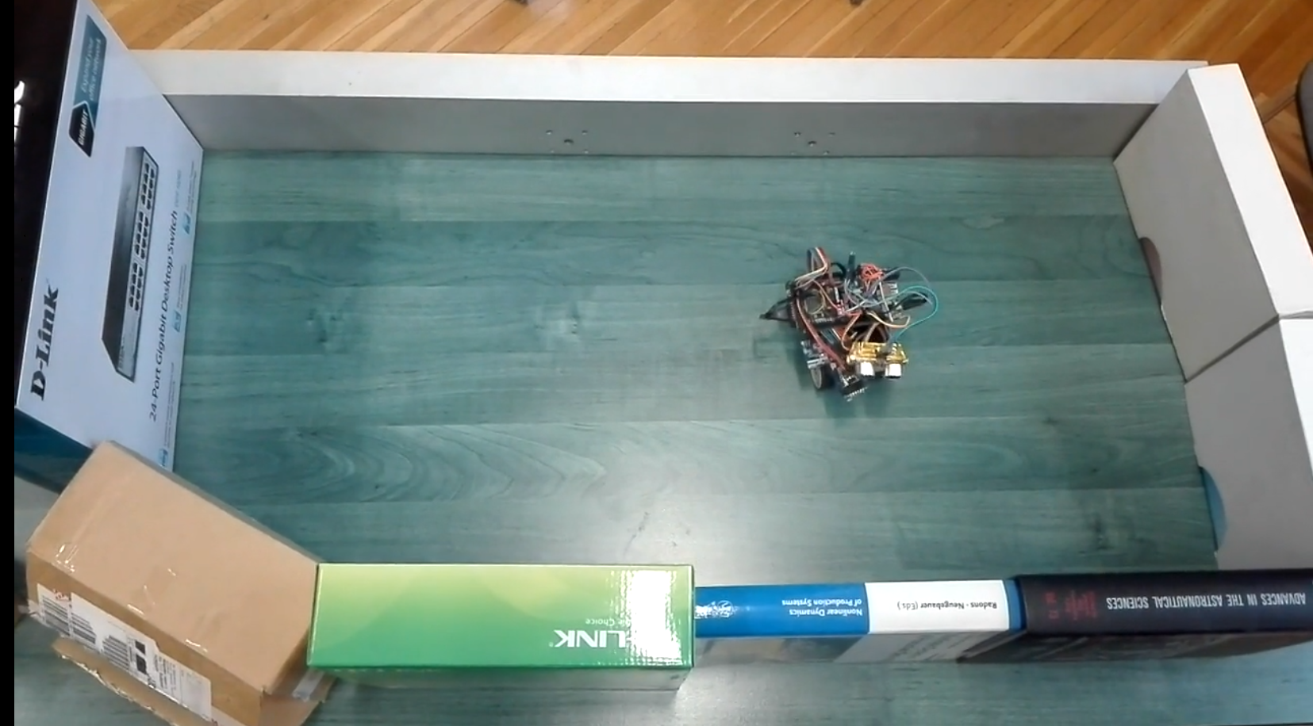

Slide 5
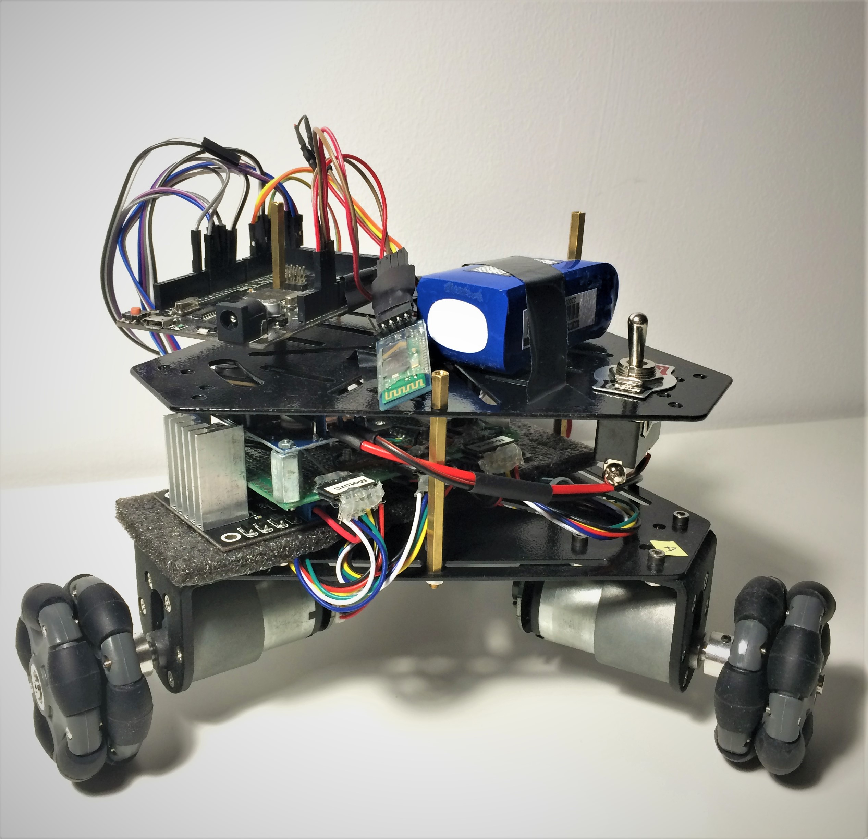
Arduino MCU
Bluetooth Module
Battery
ON/OFF
Motor Driver
Other electronics
Motors
Omni wheels

Slide 6
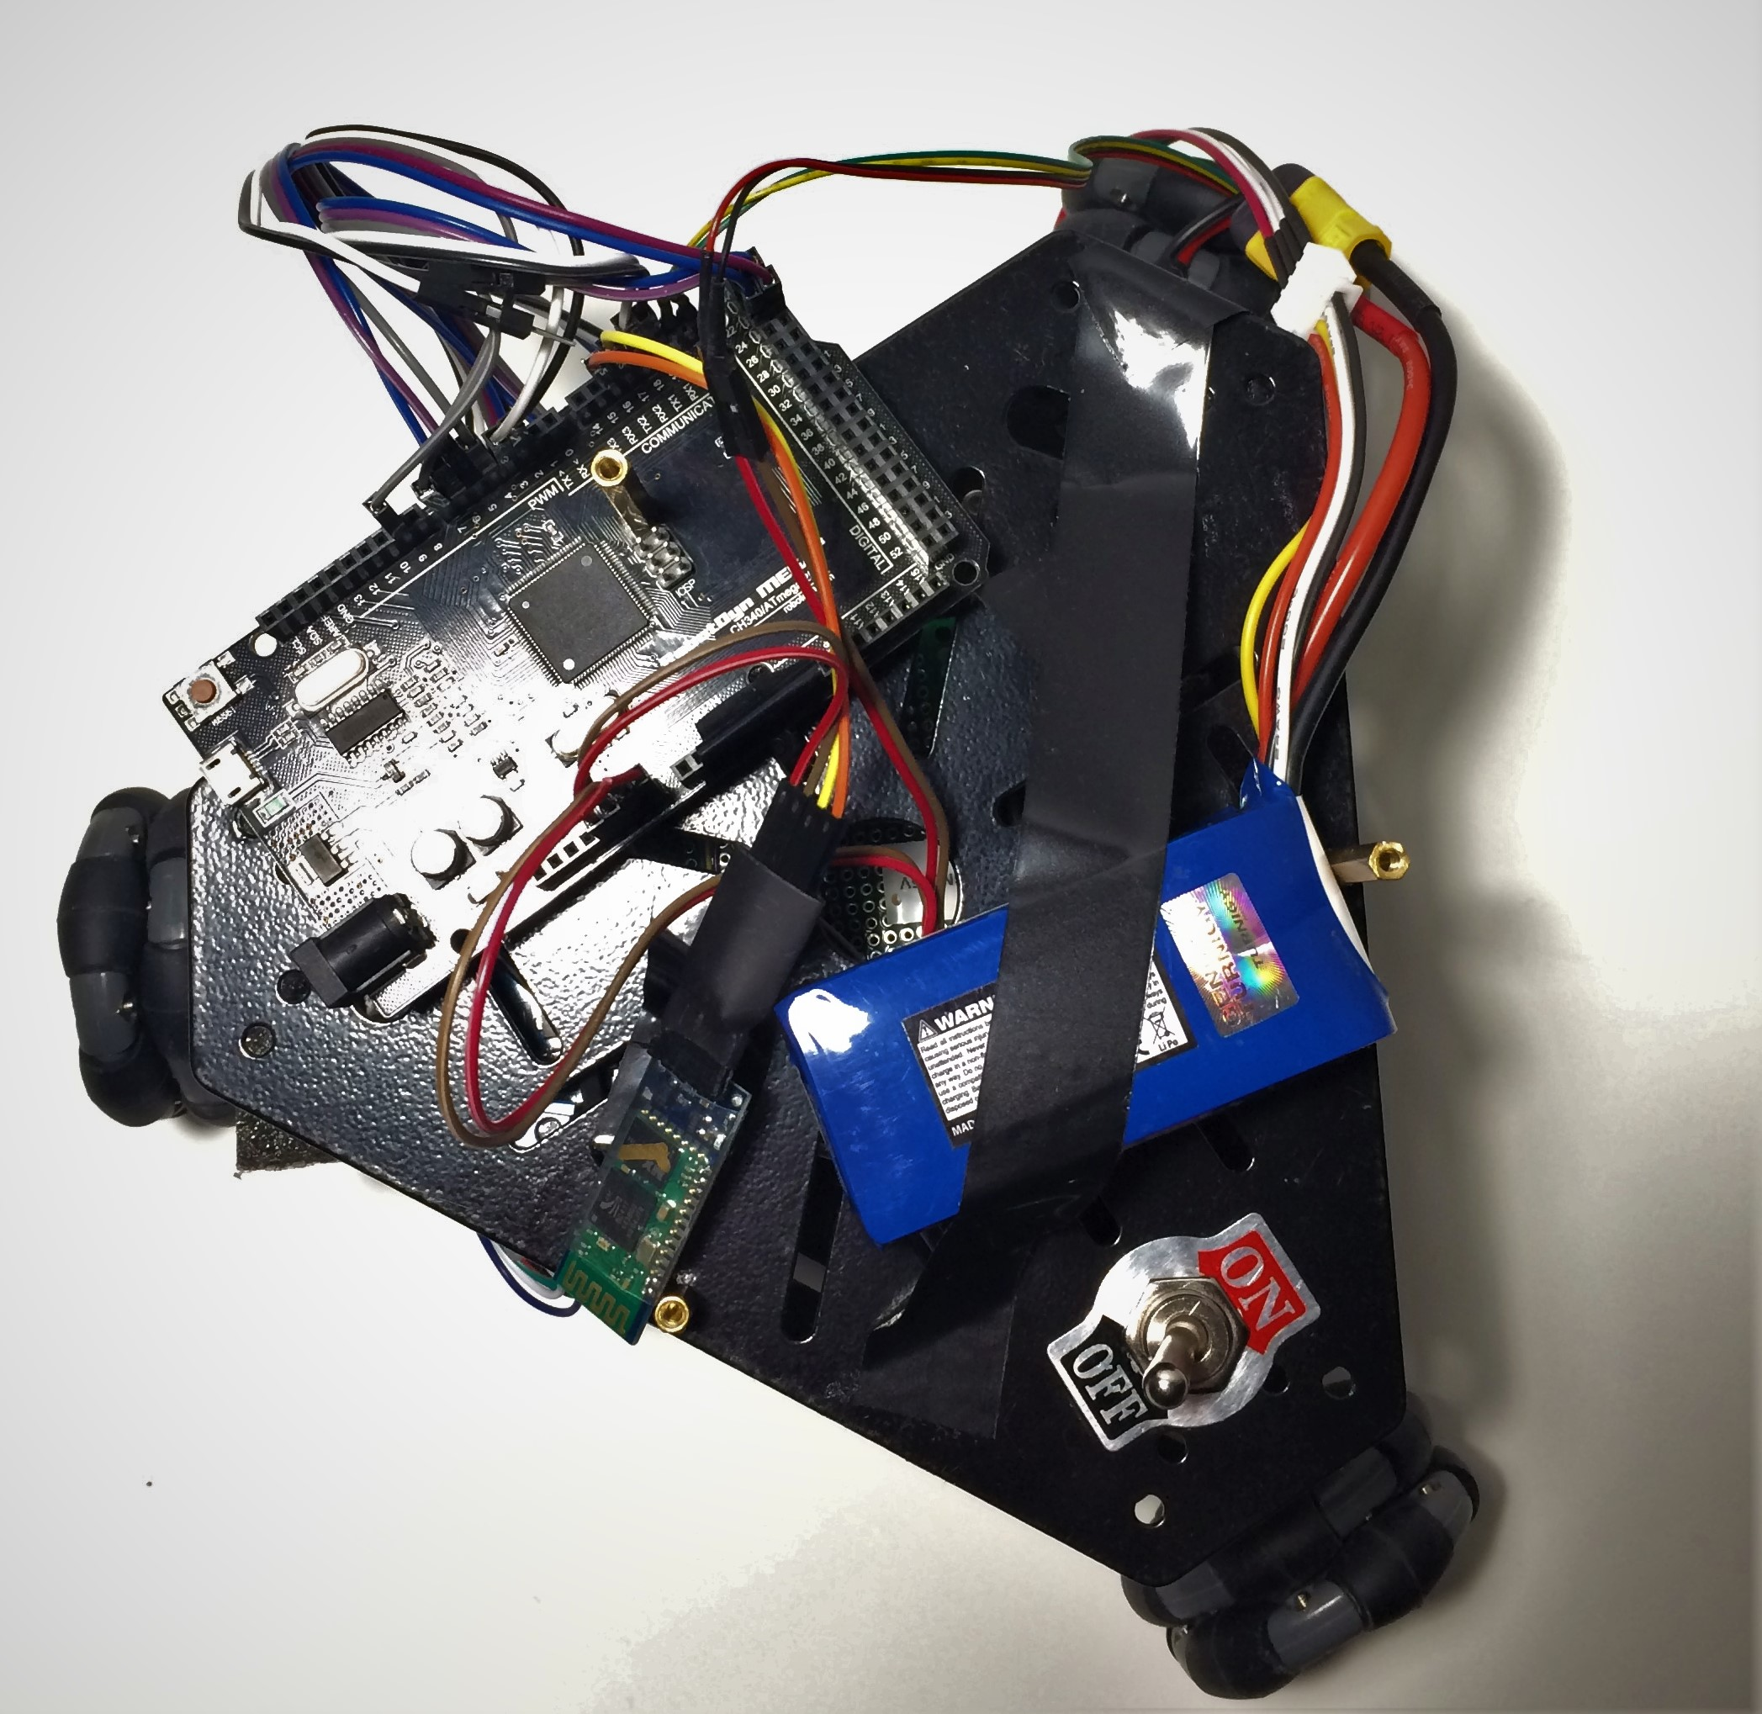

Slide 7
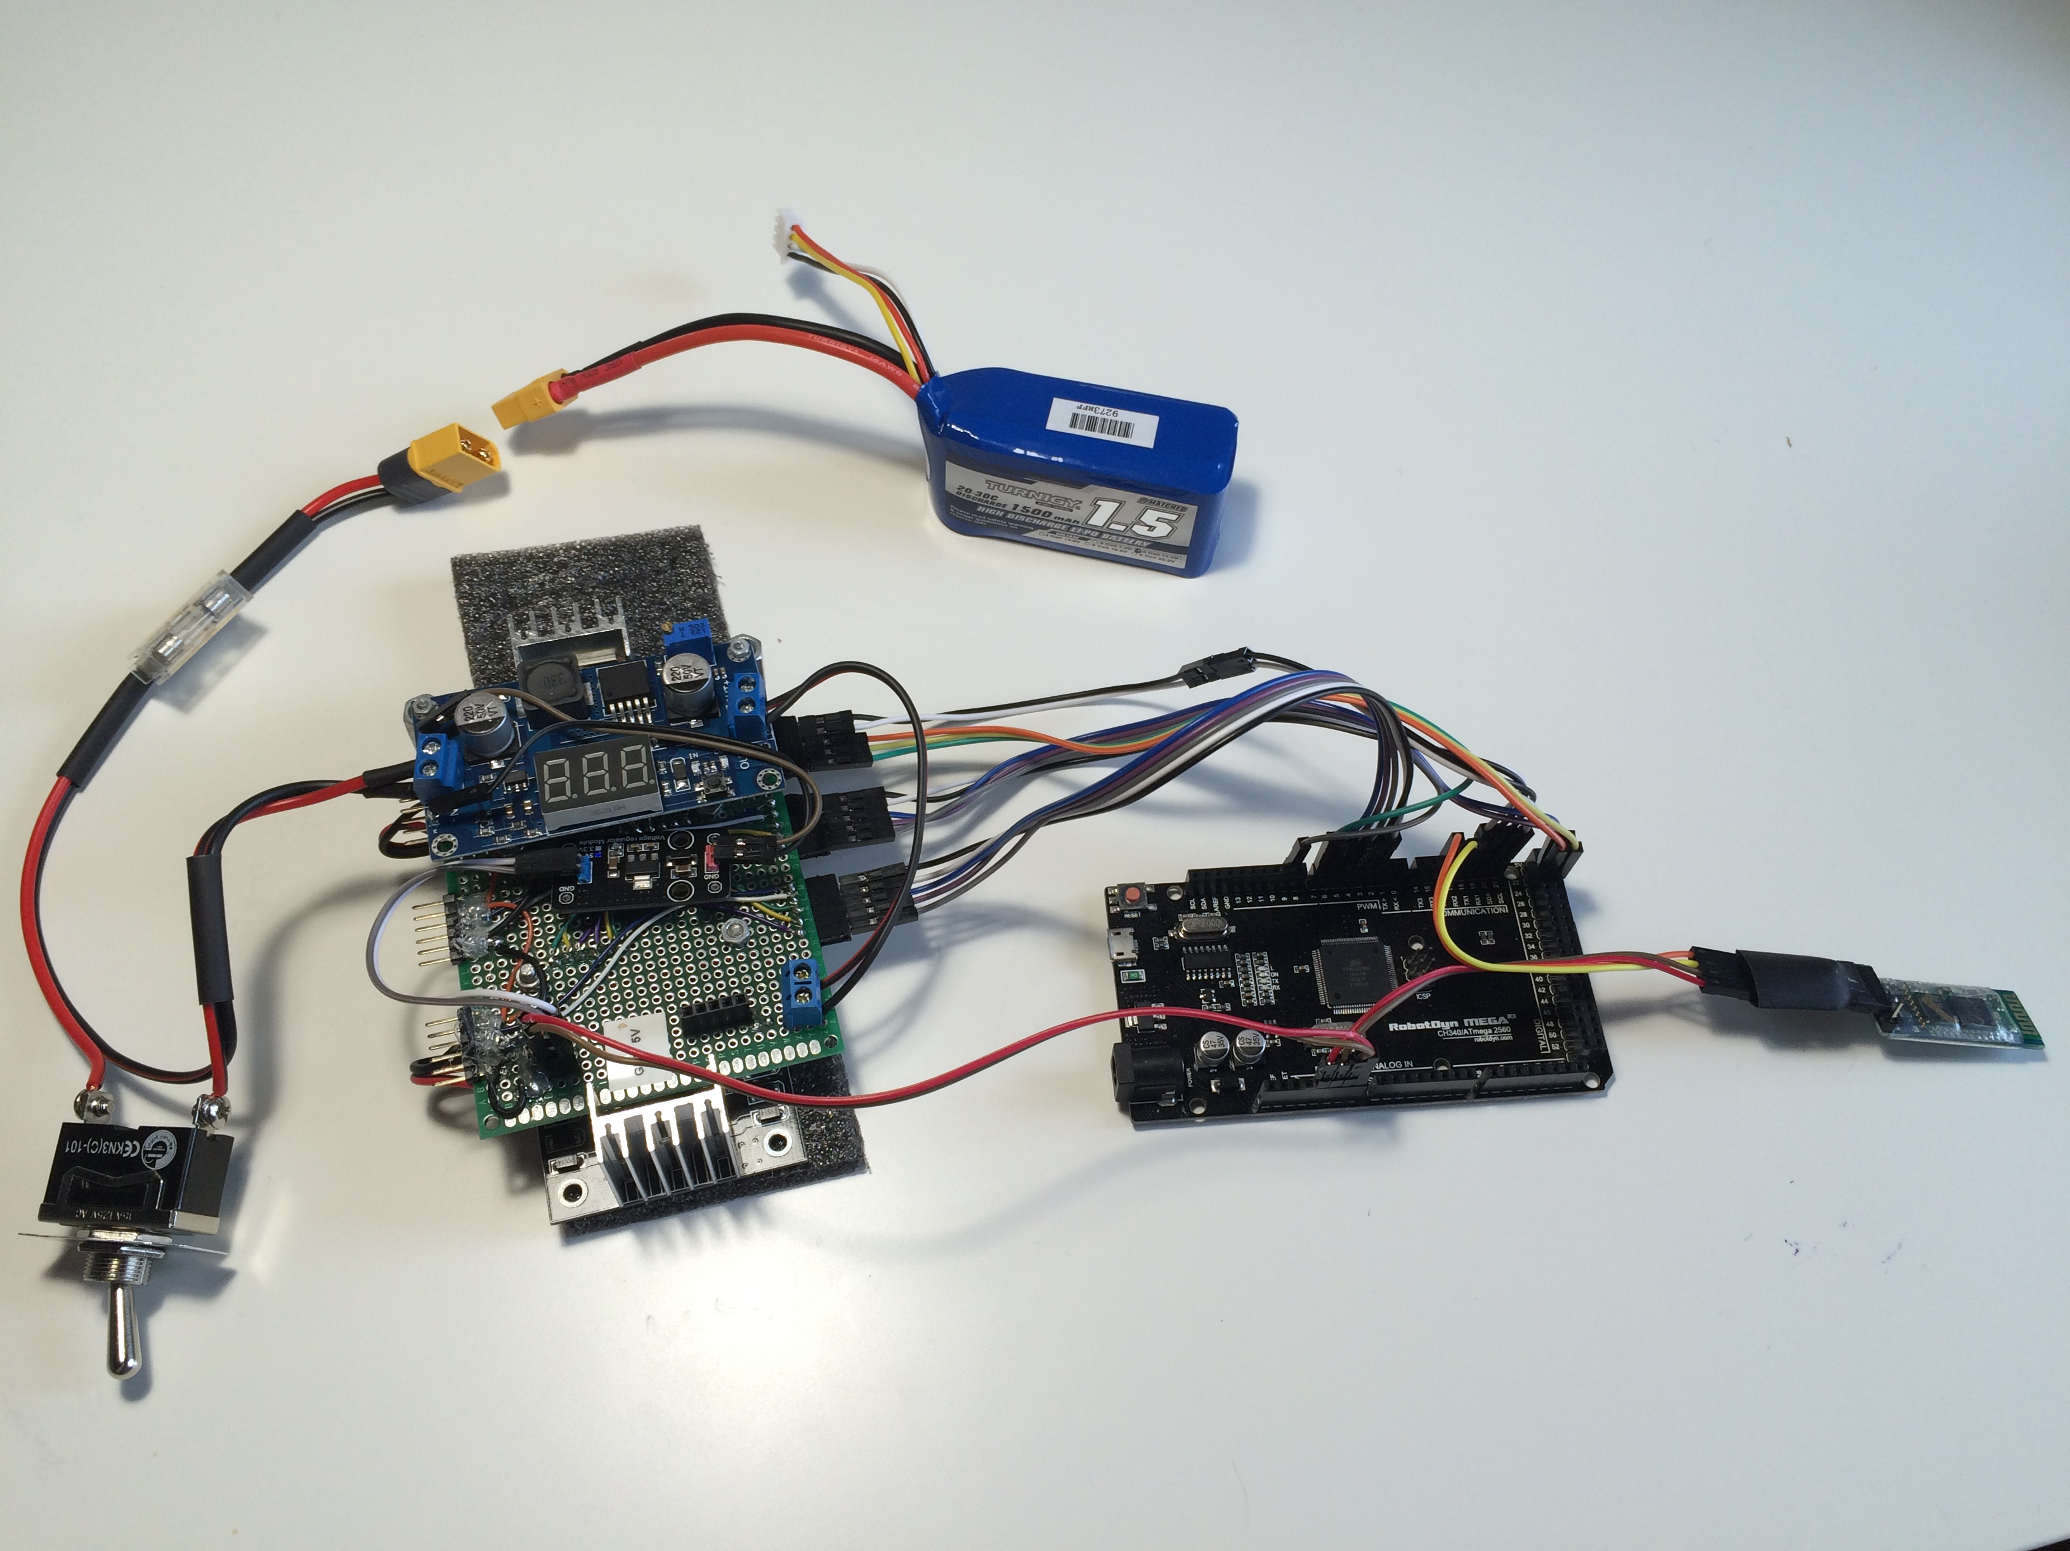
Step Up
Fuse
Battery
Voltage Regulator
Bluetooth Module
Arduino MCU
ON/OFF
Motor Driver

